Slide 1
Oxford Street 2
progress update
Paul Cullinan
NHLI: Fan Chung/Rudy Sinharay/Peter Collins
KCL: Ben Bradshaw et al.
Exposomics November 2014

Slide 2
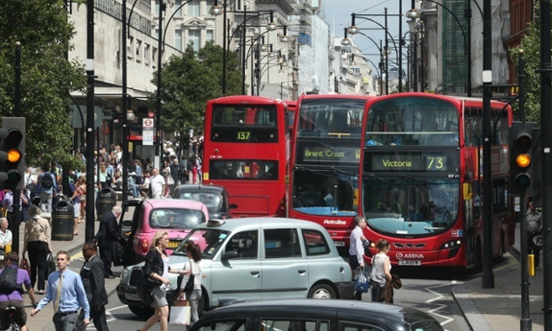
Boris Johnson admits London's Oxford Street is one of world's most polluted
London mayor makes u-turn over Oxford Street’s pollution levels in a letter to the EAC about research funding for King’s College, that made the original claim on air quality.
13 Nov 2014
24 comments

Slide 3
cross-over design
40 each:
COPD (moderate)
IHD (stable, no COPD)
Healthy (neither of above)

Slide 4
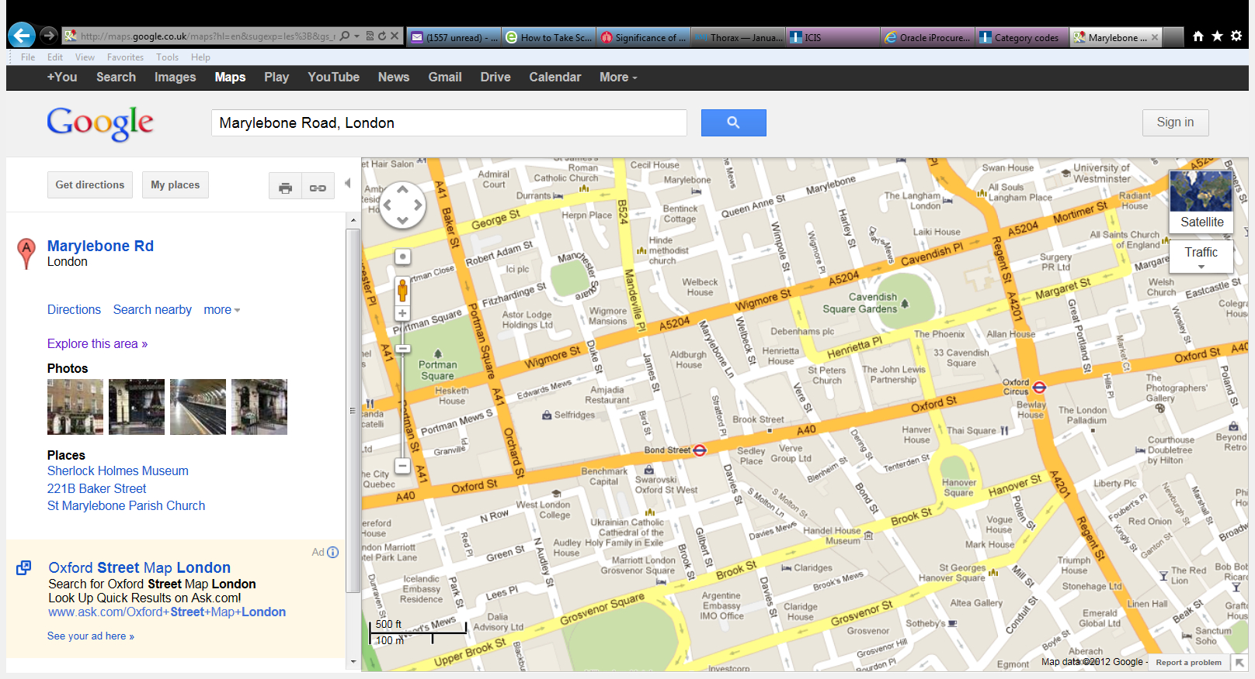
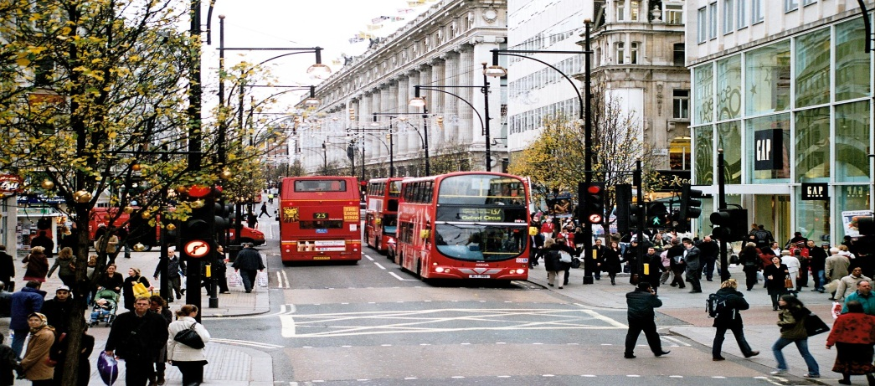
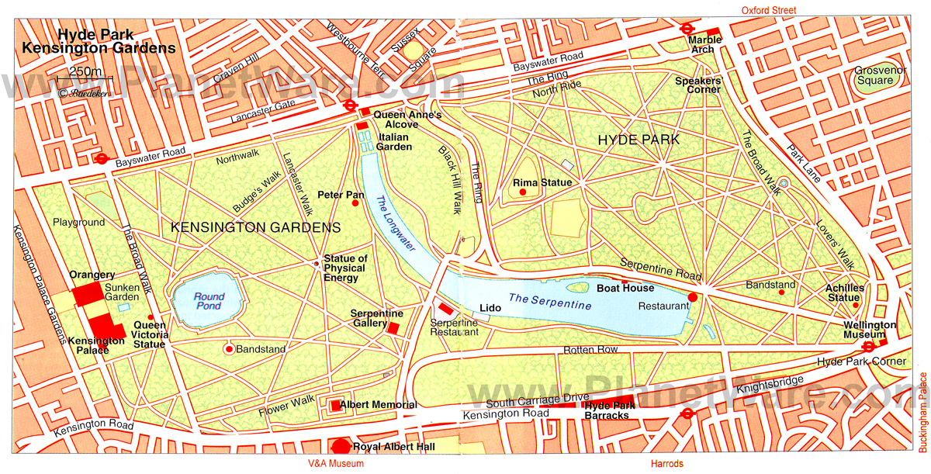
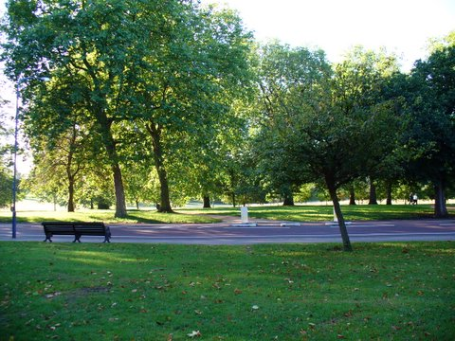

Slide 5
clinical measurements
 | Schedule of measurements
time re. exposure | -2hr | 0hr |  |  | +1hr | +2hr | +3hr | +4hr | +24h
place | lab. | site | site | site | lab. | lab. | lab. | lab. | lab.
time | 8am | 10am | 11am | noon | 1pm | 2pm | 3pm | 4pm | noon
symptoms | X | X |  | X |  | X |  | X | X
arterial stiffness | X |  |  |  | X | X |  | X | X
continuous ECG |  | X
venesection | X |  |  |  |  |  |  | X | X
urine collection | X |  |  |  |  |  |  |  | X
spirometry | X | X | X | X | X |  | X | X | X
ios |  |  |  |  |  |  |  | X | X
EB condensate | X |  |  |  |  | X |  |  | X
induced sputum |  |  |  |  |  |  |  |  | X

Slide 6
pre-exposure questionnaires: geography
postcodes
home
work
significant other
today’s date
how did you get here today? |  | tube(✓) |  | bus(✓) |  | car(✓) |  | motorbike(✓) |  | bicycle(✓) | walk(✓)
Where were you? (tick one or more)
 | home (✓) |  | work (✓) |  | significant other (✓) |  |  |  | any other? (describe)
yesterday
-2
-3
-4
-5
-6
-7

Slide 7
pre-exposure questionnaires: diet
 |  | breakfast | lunch | supper | other
yesterday | time
 | place
 | food and drink
today | time
 | place
 | food and drink
tomorrow | time |  | blank
 | place
 | food and drink

Slide 8
exposures (n=c.120 measurements)
 | Hyde Park | Oxford Street | P
 | median | median
distance walked | 5.3mi | 5.3mi
temp | 18.0 | 18.9 | >.05
RH | 51.3 | 50.9 | >.05
noise | 73.4 | 75.2 | <0.001
PM_{2.5} | 7.5 | 18.1 | <0.0001
PM₁₀ | 16.1 | 24.7 | <0.0001
ultrafine n | 5709 | 25472 | <0.0001
carbon black | 1.2 | 10.4 | <0.0001

Slide 12
participants
 |  | male N | age | FEV₁ % pred | FVC % pred | PWV m/s | AI % | IOS 5Hz kPa/L/s
COPD | 40 | 19 | 68 | 58 | 88 | 9.3 | 26 | 0.57
IHD | 39 | 35 | 67 | 97 | 100 | 9.4 | 25 | 0.47
healthy | 39 | 19 | 62 | 98 | 106 | 8.3 | 25 | 0.40

Slide 13
FEV₁
healthy
COPD
IHD

Slide 14
impulse oscillometry (5Hz)
healthy
COPD
IHD

Slide 15
AI
healthy
COPD
IHD

Slide 16
Next steps
samples to labs
‘exposomic’ questionnaire information
analysis …

