Slide 1
Personal exposure monitoring in EXPOsOMICS: what does it add?
John Gulliver
Imperial College London
King’s College London
CREAL (Barcelona)
University of Utrecht
Swiss Tropical and Public Health Institute

Slide 2
Primary objective of personal exposure monitoring (PEM)
EXPOSOME
Environmental
exposures
Biomarkers (omics)
PEM 1
PEM 2
PEM 3
160 adults and 40 children
24-hour air pollution measurements, biological samples, and questionnaires

Slide 3
Objectives
To develop an integrated smartphone based system for measuring positioning, physical activity/inhalation and air pollution levels (fine (PM_{2.5}) and ultrafine (UFP – PM_{0.1});
To deploy the system to make repeated, detailed personal and residential (i.e. fixed-site, outdoors) measurements in five European cohorts [adults – EPIC-Netherlands (Amsterdam and Utrecht), ECRHS-UK (Norwich), SAPALDIA-Switzerland (Basel), EPIC-Italy (Turin); children – INMA-Spain (Sabadell)];
Develop new land use regression models for UFP (supported by a comprehensive spatial assessment of measured concentrations of UFP in this study) and oxidative potential (from PM_{2.5} filters from the ESCAPE study);
Study the potential for misclassification in traditional methods of exposure assessment by comparing exposures measured and modelled outdoors at address locations with personal exposure estimates;
Use the results of the study to inform the development of personalised exposure models that account for micro-environmental differences in exposures in space and time.

Slide 4
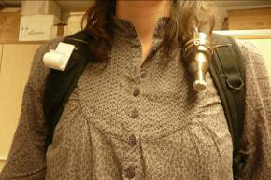
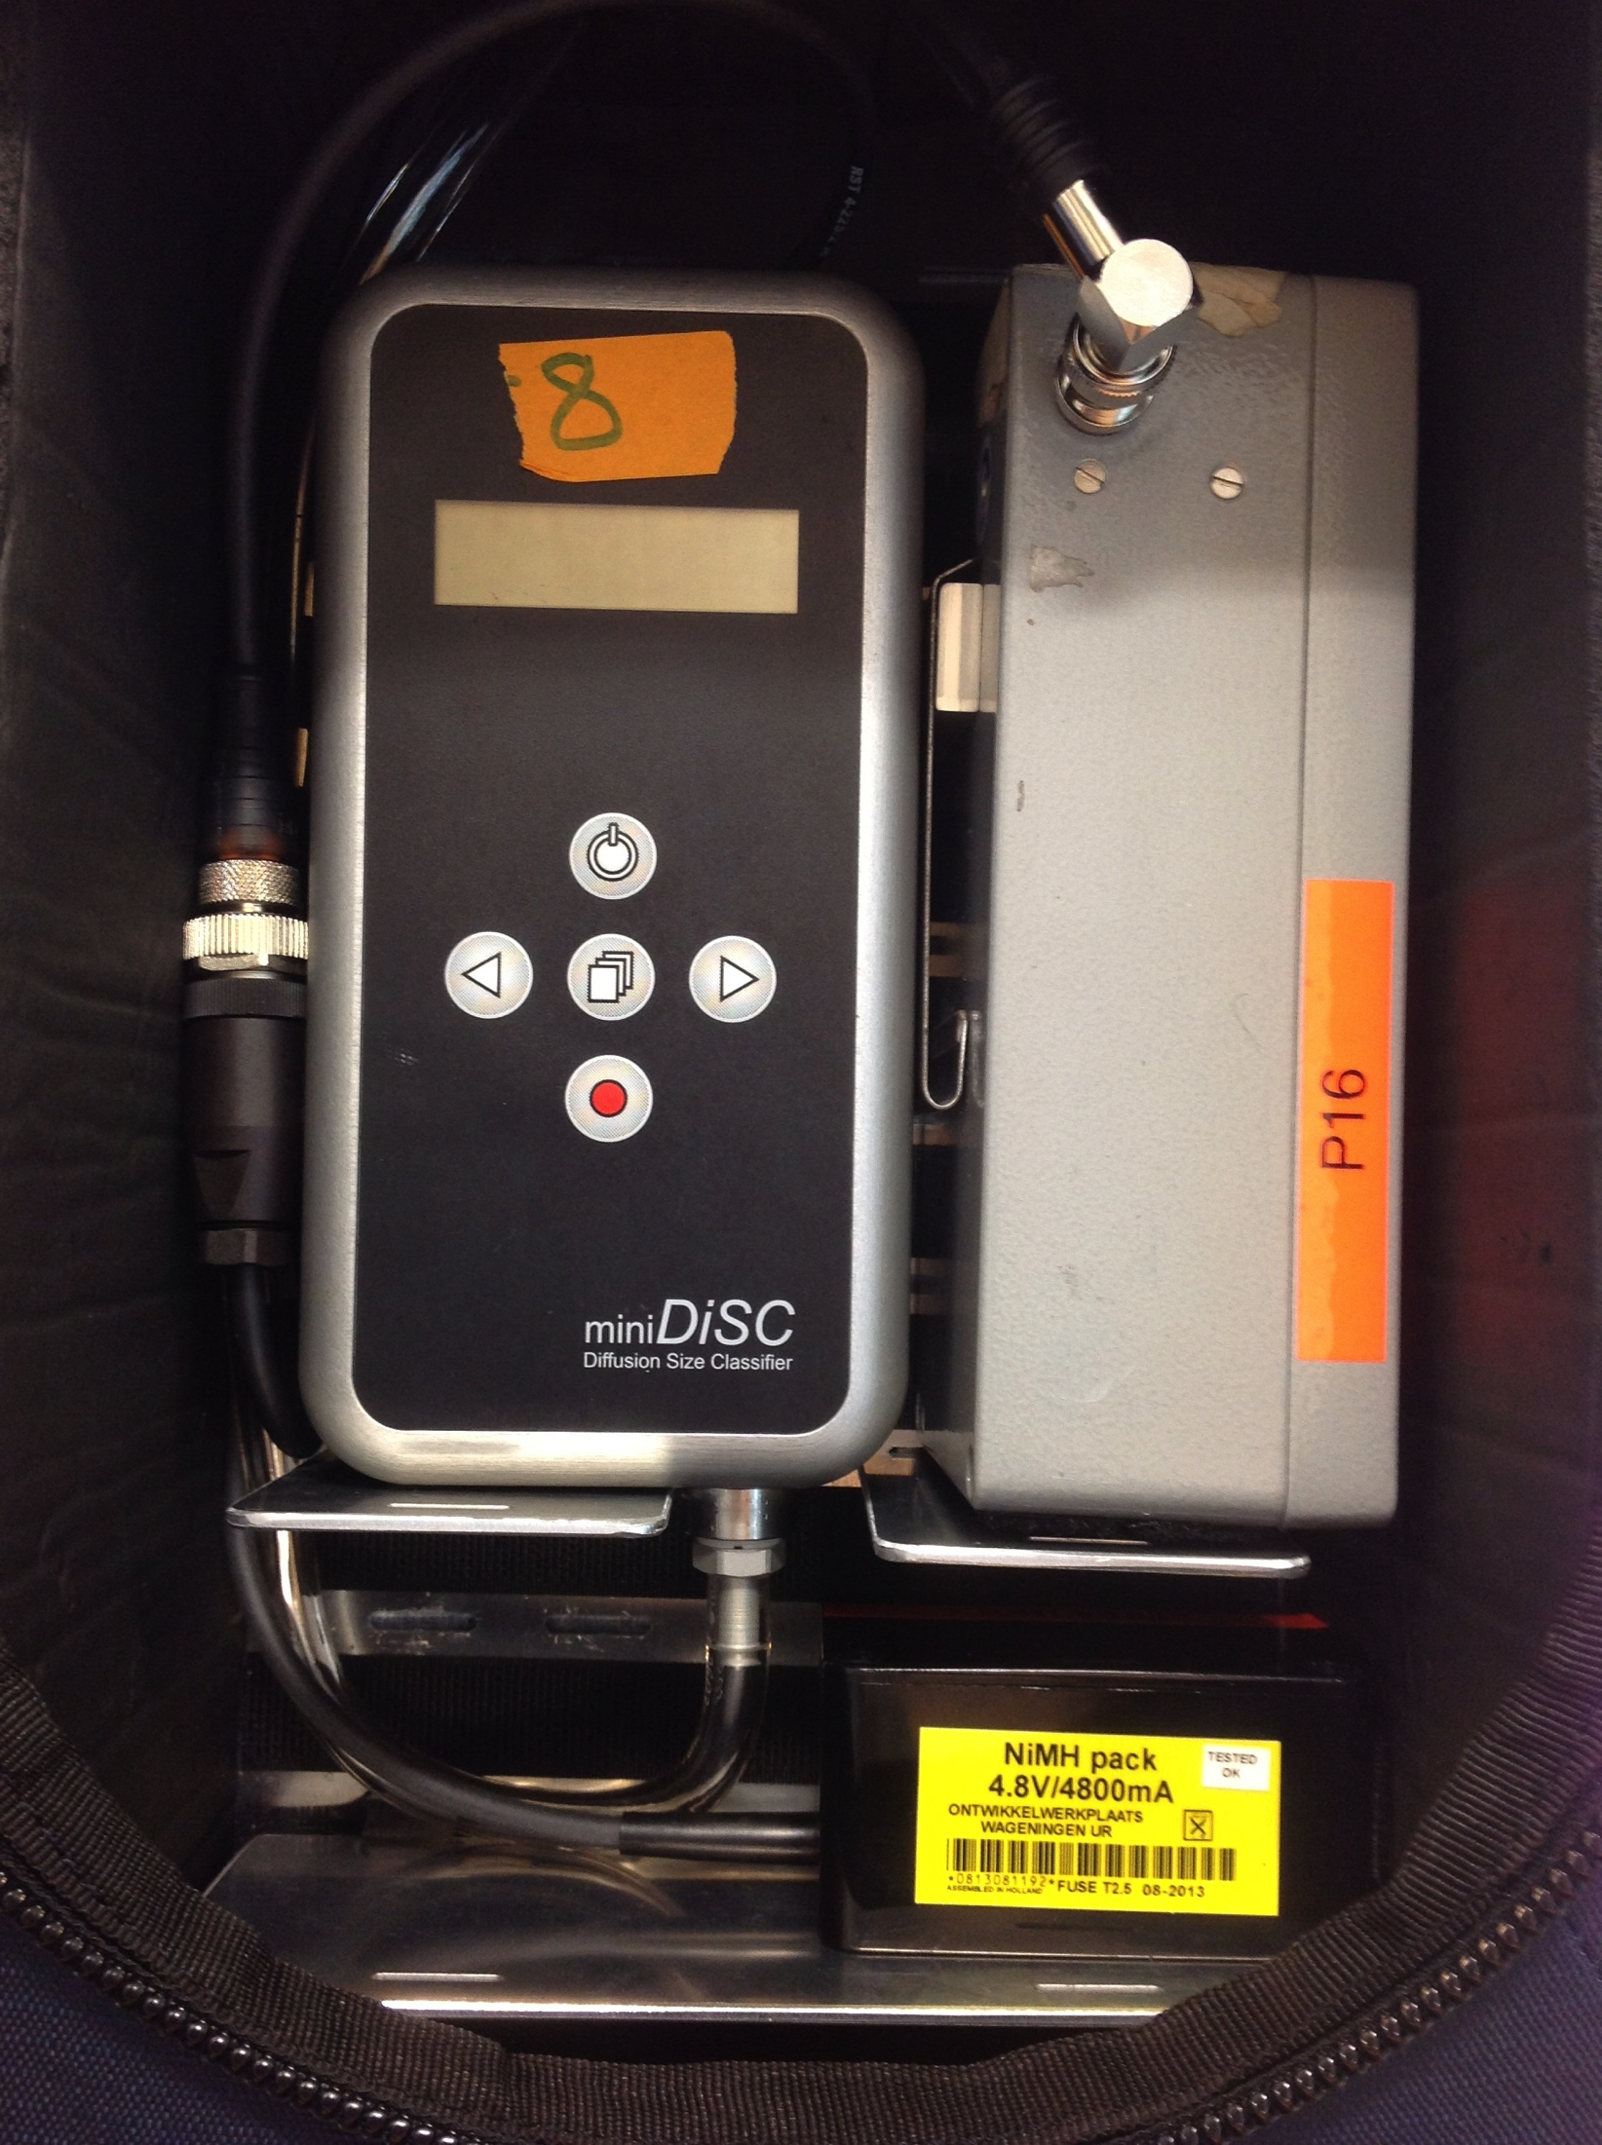
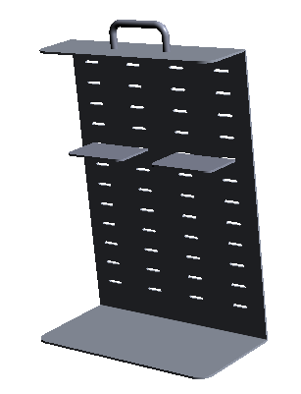
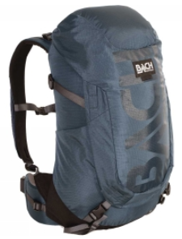
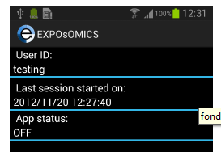
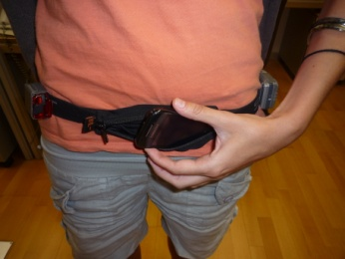
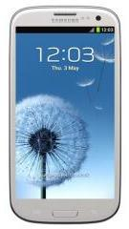
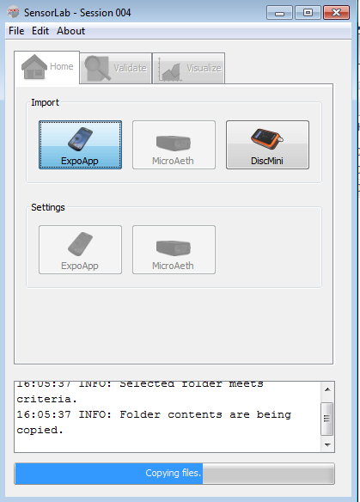
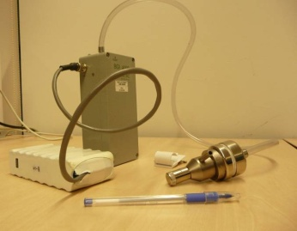
Sensor tubes/inlets
fitted to shoulder straps
Separate GPS & accelerometer
(used for validation of data from the phone)
Bespoke phone
application
(GPS, accelerometer)
Bespoke rack inside backpack to hold sensors and batteries
Bespoke software
to process data from sensors
Battery
support
for sensors
PM2.5 pump/
cyclone
UFP DISCmini
SD card
PM2.5 mass and soot
PROCESSED
DATA
Filter analysis

Slide 5
Participant selection criteria
Subjects enrolled in an existing cohort and have provided a baseline (i.e. archived) blood sample
40 participants per study area
Equal numbers of males and females (i.e. to cover possible gender-related response differences)
50% living on a major road (>10k AADT; >5K AADT in a street canyon) at ground level; 50% in background locations
Age 50-70 at the time of the first PEM session
Exclusion criteria (some of which can’t be met)

Slide 6
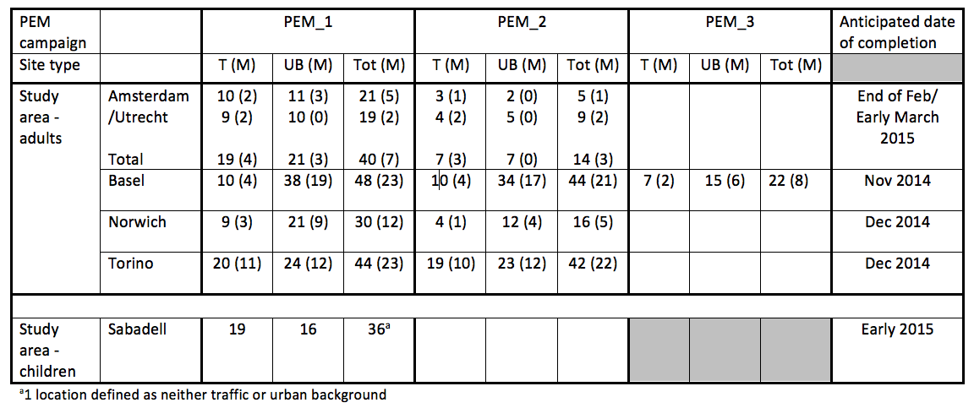
Status of PEM campaigns by centre (1st October 2014)

Slide 7
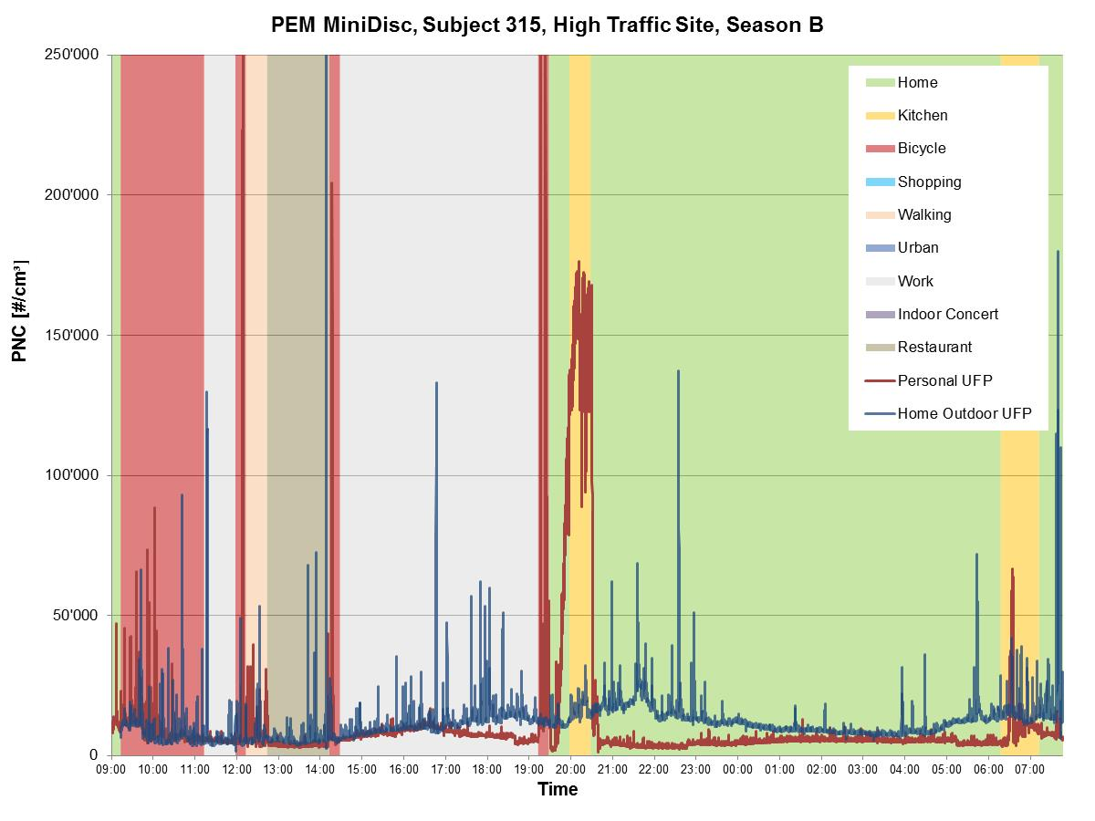
Mean UFP:
Pers: 10,800
HO: 11,600
Notes:
Subject: Female, 55 years old, working full time. Active.
This day: film crew filmed her from 09:00 till 14:00. Worked till late, cooked at 20:00.
Footage: SRF Swiss broadcasting company, (Einstein: 15.05.2014)
MING: HIGH TRAFFIC SITES HAVE VERY CHOPPY/PEAKY HOME-OUTDOOR TRACES AND HIGH MEAN UFP VALUES (>10K).

Slide 8
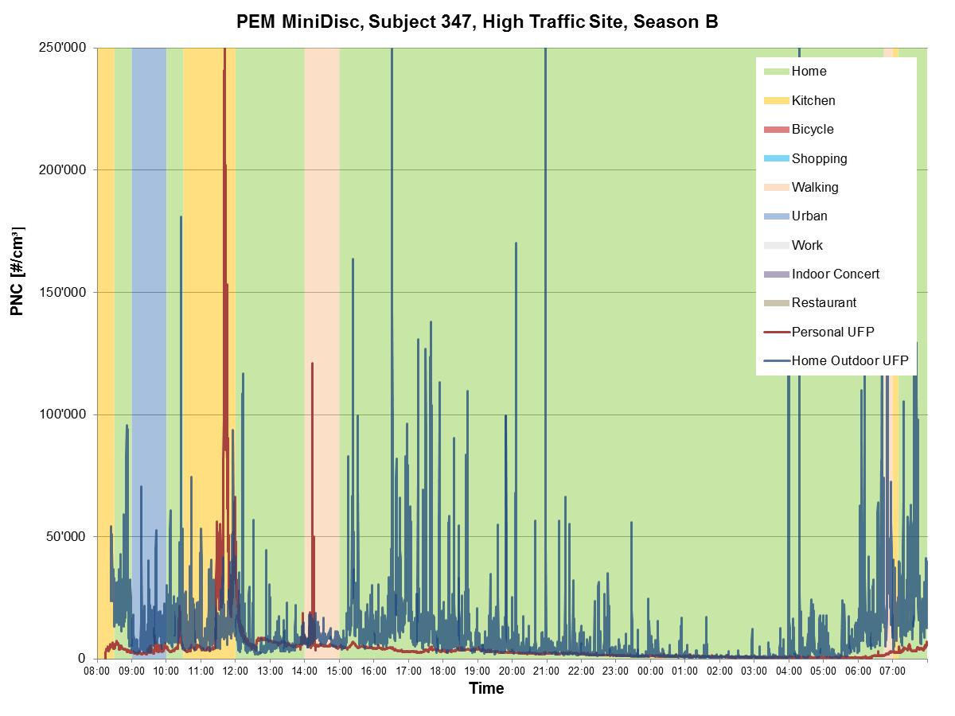
Mean UFP:
Pers: 4,400
HO: 10,500
Notes:
Subject: Female, 70 years old, retired. Not very active, has a dog and goes for walks.
Was at home most of the time, cooked at noon. Went for a walk with the dog in the afternoon.

Slide 9
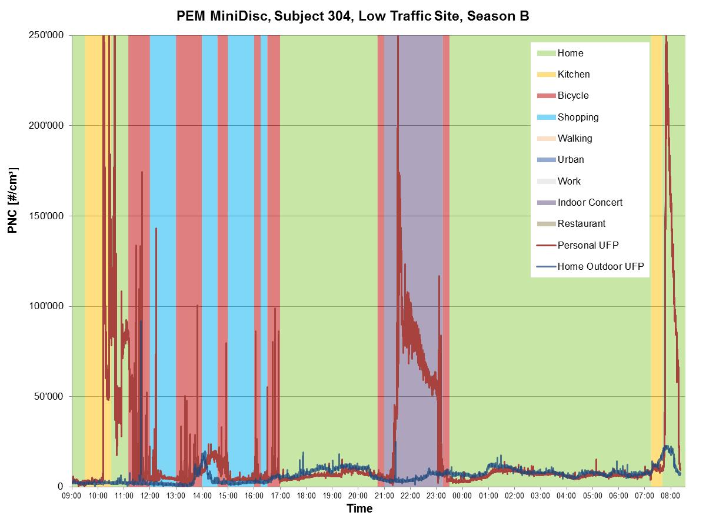
Mean UFP:
Pers: 18,400
HO: 6,200
Notes:
Subject: Male, 64 years old (retired), very active.
Made a pie in the morning (that is why the concentration rises after being in the kitchen, as pie was in the oven), went shopping in the afternoon. From 21:00-23:15 at a concert (indoors).
MING:
BOTH OF THESE 2 LOW-EXPOSED INDIVIDUALS (304&311) HAVE A HIGHER 24-HR MEAN UFP THAN THE OTHER 3 HIGH EXPOSED PEOPLE WE EXAMINED!

Slide 10
UFP mobile monitoring campaigns
to develop UFP LUR models for each study area
overlaps with PEM campaigns
repeated short-term monitoring (30-minutes per site)
160 sites per study area (240 sites in NL) x 3
40% traffic locations; 40% urban background locations; 20% other locations (e.g. green space, industry)
~8 site visits per day
UFP measured by Condensation Particle Counter (CPC)

Slide 11
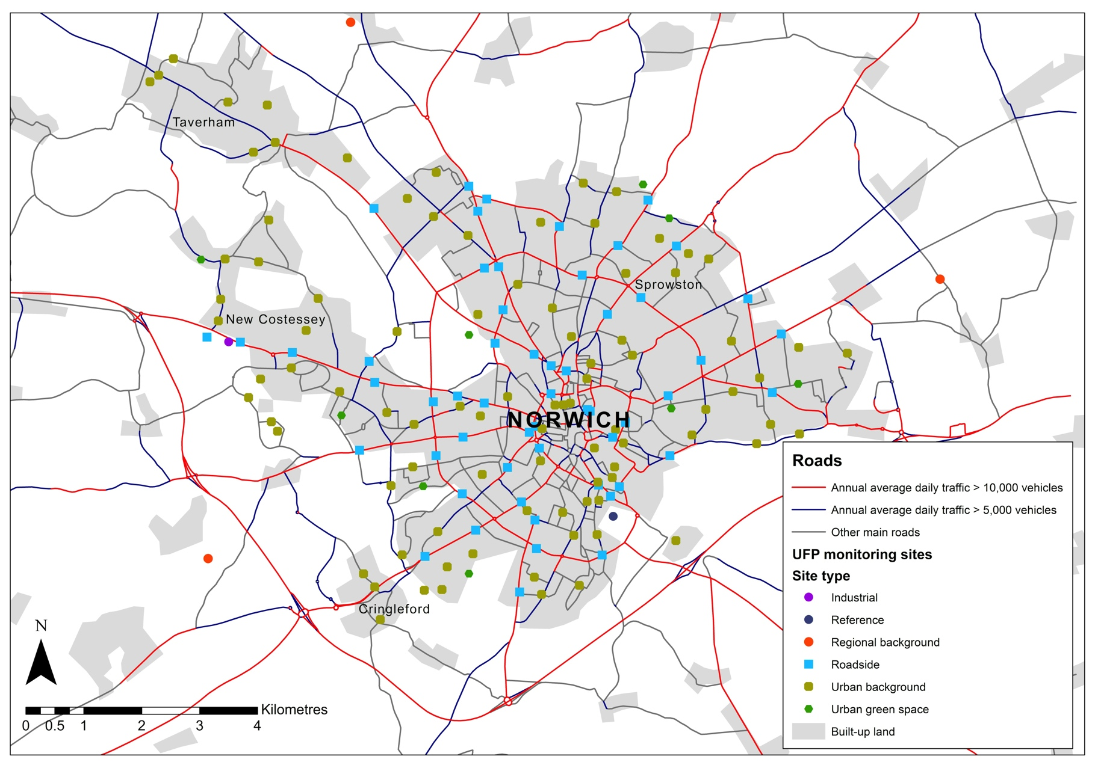
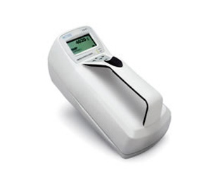
Location of UFP measurement sites in Norwich

Slide 12
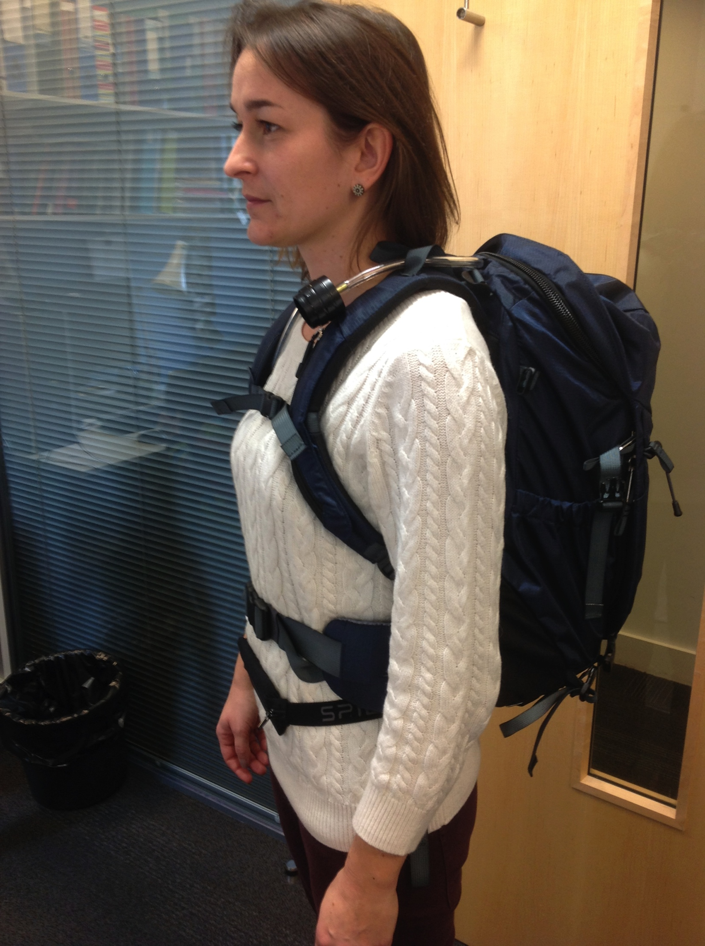
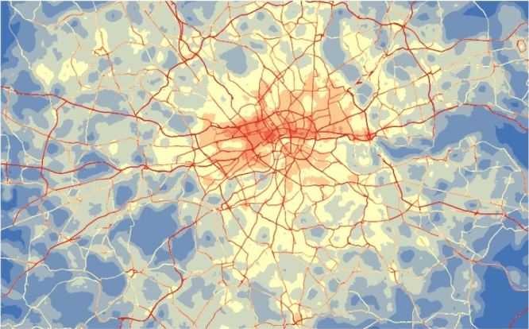
AIR POLLUTION MEASUREMENTS AT HOMES
Outdoor
monitoring
Backpack indoors
Networks of air pollution sensors
created to develop and validate land use regression models
Personal Exposure
Monitoring (PEM)
Space-time patterns of exposure
(e.g. homes, work, journeys)
Land Use Regression models
developed in EXPOsOMICS for
mapping concentrations of
outdoor air pollution (+ESCAPE models)
One continuous reference site per study area to study temporal variability in air pollution

Slide 13
Analysis of PEM and modelled exposures
Relationship of personal PM2.5 and UFP
Contribution of micro-environmental UFP to total UFP exposures (accounting for inhalation rates)
UFP in different transport modes
Relationship of measured outdoor PM2.5 at homes and personal PM2.5
Relationship of modelled (i.e. LUR) outdoor home PM2.5 and UFP and personal PM2.5 and UFP
Relationship of modelled outdoor UFP, OP and PM2.5 at homes
Study exposure misclassification related to exposure estimates from outdoor air pollution models

Slide 14
Any questions?

