Slide 1
Metabolomics in PISCINA II part of the EXPOsOMICS project
Karin van Veldhoven
Imperial College London
Investigators meeting EXPOsOMICS
26/11/2014

Slide 2
Metabolomics in EXPOsOMICS
Study | Exposure markers | N metabolomic features | N samples | Data received?
ALSPAC | Air pollution: PM, NOx, UFP | 231 annotated | 5,524 | PARTLY
TAPAS2 | Air pollution: PM, NOx, UFP | ? | 120 | NO
PISCINA air | Air pollution: PM, NOx, UFP | ? | 120 | NO
PISCINA water | Water pollution: THM, HAA, HK, HAN | 20,325 6,781 annotated | 120 | YES
EXPOsOMICS
Identification of internal markers of external exposure
Relate markers of exposure to the disease outcome and elucidate how their effect is mediated

Slide 3
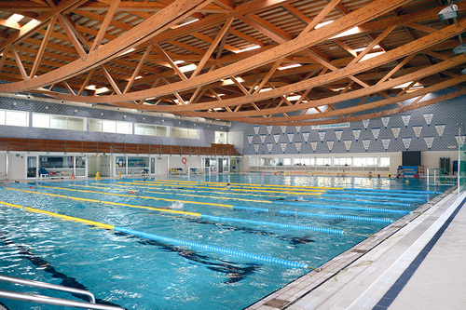
PISCINA study
Ongoing experimental study of swimmers in pools
Exposure to water disinfection by-products (DBPs) and their short-term effects
Extensive identification of DBPs in swimming pool water and air as well as biological samples (exhaled breath, blood and urine) and identify:
Mutagenicity
Genotoxicity
Short-term respiratory health effects

Slide 4
Why disinfection by-products
Disinfection by-products (DBPs) – formed by the reaction of dis-infectants with natural organic matter – unintended consequence of trying to kill pathogens in drinking water and swimming pools
Primary routes of exposure in pools - inhalation
- dermal absorption
> 600 DBPs identified in drinking water – many mutagenic or carcinogenic
Respiratory irritation
Increased risk of bladder cancer
Mutagenic levels in swimming pool water were found to be similar to that of drinking water (Richardson et al)

Slide 5
Disinfection by-products
 |  | Chloroform | Bromoform | Heloacetic acids
IARC classification: Possibly carcinogenic to humans |  | X | X | X
Mutagenic |  |  | X | X
Cytotoxic |  | X
Regulated | Drinking EU | X | X
 | Drinking US | X | X | X
 | Pools

Slide 6
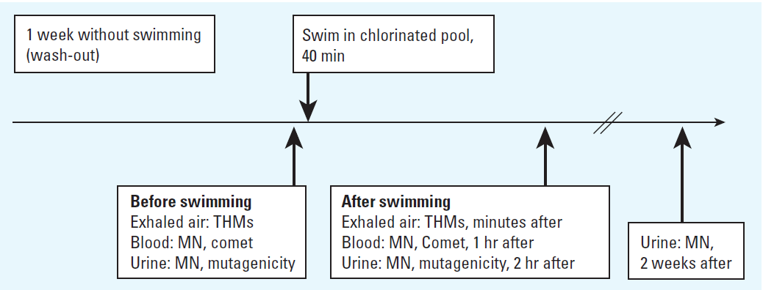
PISCINA I
Precursor - PISCINA I: 50 healthy, non-smoking adult volunteers
Exposure to DBP
Short term respiratory health effects
Genetic damage after swimming

Slide 7
Summary results PISCINA I
Many new DBPs identified – not previously reported in swimming pools or drinking water
After swimming
concentration of DBPs in exhaled breath 7x higher
↑ micronucleated lymphocytes (genotoxicity)
↑ urine mutagenicity
↑ serum CC16 levels (marker of lung epithelium permeability)
Exhaled bromoform associated with gene expression changes: 11 genes upregulated, 9 enriched to airway inflammation

Slide 8
PISCINA II
Follow-up of PISCINA I – Short-term study carried out at CREAL (Barcelona) between June and December 2013.
Aim – detailed, expanded exposure assessment of DBP in swimming pools and the impact on biomarkers of effect: - genotoxicity (micronuclei in lymphocytes and reticulocytes)
- respiratory (cc16)
- mutagenicity
- omics (metabolomics, proteomics, transcriptomics, adductomics)

Slide 9
Design PISCINA II
Cross-over study – indoor chlorinated pool
Subjects: 120 volunteers (18-40y non-smokers, non-professional swimmers) swam for 40 minutes
30 experimental days, 4 volunteers per day, 2 days per week
Before and after (1h, 2h, 24h, 4 days) blood, urine, exhaled breath samples collected
Metabolomics (LC-MS) analysed in blood samples collected before and 2h after swimming (n=60)
Internal dose
Biological
samples:
-
biomarkers of effect
-
Swimming 40 min
1 week without swimming
1 day without physical activity
Environmental DBP levels
Physical activity

Slide 10
External exposures DBP measured in swimming pool water
Category | Nr. of species
Trihalomethanes (THM) | 4
Haloacetic acids (HAA) | 9
Haloketones (HK) | 1
Haloacetonitrilles (HAN) | 3
Trichloramine | 1
Additional chemicals (but lower frequency) such as nitrosamines

Slide 11
Internal exposures DBP measured in exhaled breath
Category | Chemical name | Formula
Trihalomethanes (THM) | Chloroform | CHCl3
 | Bromodichloromethane | BDCM
 | Dibromochloromethane | DBCM
 | Bromoform | CHBr3
Total THM | CHCl3 + BDCM + DBCM + CHBr3

Slide 12
Data collection
Physical activity
40 minutes at a calmed pace
1 technician per participant
Distance (number of pools)
Resting time (direct count)
Subjective fatigue (Borg score) before and after
Heart rate (pulsometer Polar RCX 5)
Questionnaires
- Sociodemographics
- Regular physical activity
- Diet
- Diary of recent activities

Slide 13
Metabolomics data
Metabolites
- N=20,325 peak intensities from GeneData
> N=6,781 annotated
- N=3,608 peak intensities from IARC
> None annotated
- raw spectral data

Slide 14
Main streams of analyses
Exposure vs metabolites
Single exposures and combinations of exposures vs metabolites → guidance re exposures from CREAL
Exposures vs changes in metabolites (before and after swimming) → paired analyses

Slide 15
Main streams of analyses
Metabolites vs outcome
Cluster individuals with respect to their short-term metabolic response to exposure
Identify relationship between individual heterogeneity in the metabolic responses to exposure and:
Genotoxicity (micronuclei in lymphocytes and reticulocytes)
Respiratory biomarker (CC16)
Mutagenicity

Slide 16
Pre-processing, quality checks
Check exposure distribution
Check association with exposures of interest and age, sex, BMI, other potential confounders → account for these in subsequent analyses
Filtering of metabolomic features
PCA to identify outliers and main sources of variation
Notes:
1. Preprocessing and quality check, data exploration:
-> check exposures(s) distribution
-> check association with the exposure(s) of interest and age, sex, bmi
-> as well as lifestyle factors when available to define the confounders
-> that need to be accounted for in subsequent analysis check if there
-> are any outliers in the -omics dataset(s) using principal components
-> analysis

Slide 17
Univariate analyses
Benchmark model: (generalized) linear models, adjusted for potential confounders
Extension: investigating non-linear alternatives (Generalized Additive Models: GAMs)
Multiple testing correction: control FWER Comparison with alternative strategies

Slide 18
Multivariate analyses
Partial Least Squares regression (PLS)
Orthogonal Projections to Latent Structures (OPLS) or Bidirectional Orthogonal Projections to Latent Structures (O2PLS)
Exploratory use of variable selection approaches:
Penalized regression
Bayesian variable selection (BVS)

Slide 19
Validation
Cross-validation (included in O-PLS)
Independent external validation
Perhaps using MCC?

Slide 20
Pathway analyses
Metabolite Set Enrichment Analysis (MSEA)
Metscape database
Colleagues from IARC to advise

Slide 21
Descriptive – study population
Table – Population characteristics
Characteristic | Number (%)
Sex
Male | 30 (50%)
Female | 30 (50%)
Age (years)
Mean (± sd) | 25.04 (5.25)
Range | 18.04 – 37.85
BMI
Mean (± sd) | 23.74 (3.29)
Range | 16.55 – 32.46
Physical activity
Distance swam (m) (Mean (± sd)) | 996.2 (317.2)

Slide 22
Exposure PRE and POST swimming
Table – Trihalomethanes in exhaled breath - before and after swimming
Measurement | Difference POST - PRE swimming | P-value paired t-test
Chloroform (µg/m³) | 11.10 | < 2.2e-16
Bromodichloromethane (µg/m³) | 2.42 | < 2.2e-16
Dibromochloromethane (µg/m³) | 0.52 | < 2.2e-16
Bromoform(µg/m³) | 0.09 | 1.875e-12
Total THMs (µg/m³) | 14.13 | < 2.2e-16

Slide 23
Acknowledgements
Marc Chadeau-Hyam
Paolo Vineis
Florence Guida
Michelle Plusquin
Raphaele Castagne
CREAL + PISCINA volunteers

