Slide 1
EXPOSOMICS Pilot results EPIGENAIR
Michelle Plusquin
Paolo Vineis

Slide 2
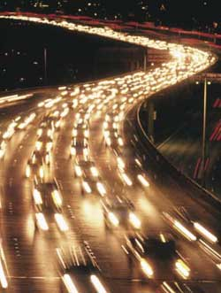
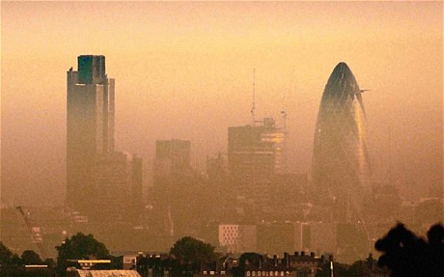
Air pOllution
Outdoor air pollution is a complex mixture containing a number of known carcinogens
Particulate matter: PM₁₀, PM_{2.5}, PM_{2.5abs}
Gases: CO, O₃, NO_{x}, SO₂
Low concentrations
Everybody is exposed

Slide 3
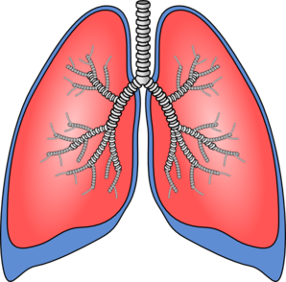
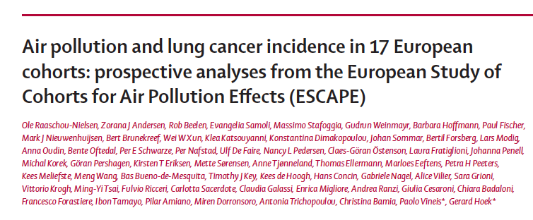
Air pollution
Pollutants in blood Systemic and in target organs:
- Inflammation - Oxidative stress
Inhalation of air pollution
Pulmonary disease
Cardiovascular disease
Cognitive impairment
Neurologic disease
Cancer
However, the exact mechanism leading to this reduced risk among
smokers is still unclear. Thus, more careful consideration of potential interaction between PM and smoking for lung cancer and other diseases seems warranted; large, robust data sets will be needed for this work

Slide 4
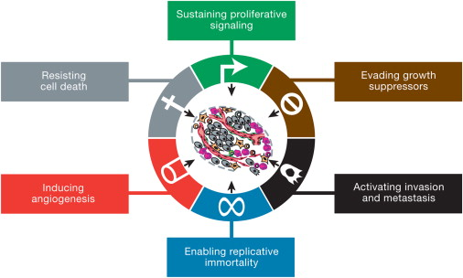
Air pollution cancer?
Components of air pollution cause
Altered gene expression by epigenetic events or transcription factors
DNA damage (adducts, strand breaks) that is processed by the cell into mutations (change in DNA sequence)
Cell 2011 144, 646-674

Slide 5
Air pollution and DNA methyLation
Global hypomethylation associated with increased air pollution
Long / short term
Techniques: LINE1, LUMA, tandem repeats, HPLC, …
Outdoor / indoor
Prenatal exposure
black carbon, PM_{2.5}, SO₂, NO₂, PAHs
Gene specific methylation
Inflammation and immunity genes
iNOS

Slide 6
Research Question: EPIGENAIR
Are there global and gene-specific DNA methylation changes associated with air pollution?

Slide 7
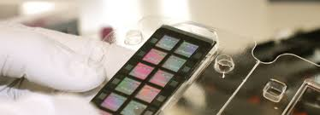
EPIGENomic markers for AIR pollution-induced health effects
Interpretation of the association between global methylation and air pollution estimates
Epigenome Wide Association Study: Interpretation of the association between single CpG site methylation and air pollution estimates
Illumina Infinium 450k Human Methylation Assay
β = M
U + M + a

Slide 8
Methods
Epic Italy, Epic Netherlands, Epic Sweden (EnviroGenomarkers)
Air pollution data Escape
Pre-processing of array data
Background subtraction
Dye base correction
Remove probes with detection p-values≥0.05
Exclude probes with >20% of samples NA
Beta-values
Beta-regression adjusted for :
chip, position, gender, age, smoking, being a case
Bonferroni correction

Slide 9
population
 | EPIC-Italy | EGM |  | EPIC-Netherlands
 |  | Italy | Sweden
Number of particpants | 457 | 79 | 406 | 169
Participant characteristics at sampling
Female n(%) | 323(71%) | 71 (90%) | 233 (57%) | 170 (100%)
Age (mean ± SD) | 54.4 ± 7.4 | 55.0 ± 8.6 | 51.39 ± 7.6 | 62.9 ± 5.3
Smoking never/past/current | 51/25/24 | 51/30/19 |  | 60/40/0
Cancers cases n(%)
Lymphoma | / | 12(15%) | 46 (11%) | /
Breast cancer | 82 (18%) | 37 (47%) | 155 (38%) | /
Colon cancer | 134 (29 %) | / | / | /
Other cancers | / | / | / | 13 (8%)
Air pollution estimations (μg/m³)
No_{x} | 93.01 ± 30.01 | 85.12 ± 42.96 | 23.12 ± 5.86 | 29.62 ± 5.73
No₂ | 50.15 ± 14.27 | 43.8 ± 18.68 | / | 19.63 ± 3.48
PM_{2.5} | 46.99 ± 4.59 |  |  | 24.48 ± 0.68
PM₁₀ | 30.10 ± 1.98 |  |  | 16.62 ± 0.39
PM_{2.5absorbance} | 3.10 ± 0.44 |  |  | 1.04 ± 0.33
PM_{coarse} | 16.8 ± 2.99 |  |  | 1.19 ±0.13

Slide 10
1st Research Question
Does air pollution cause a change in global DNA methylation?

Slide 11
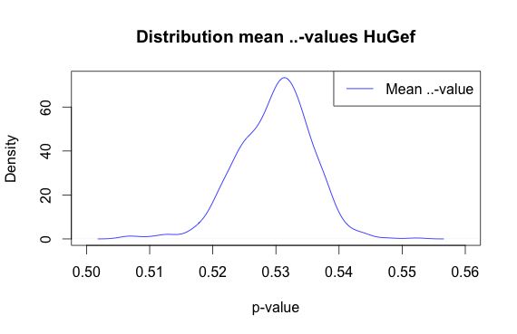
Global Methylation
 | Mean (sd)
Chomosomes
1-22 | 0.53 (0.006)
XY | 0.54 (0.054)
Relation to CGI
North shelf | 0.77 (0.008)
South shelf | 0.78 (0.008)
North shore | 0.49 (0.006)
South shore | 0.48 (0.007)
Island | 0.24 (0.007)
Functional region
Transcription start site -1500 | 0.40 (0.006)
Transcription start site - 200 | 0.21 (0.007)
5’ UTR | 0.40 (0.006)
1st Exon | 0.26 (0.007)
Gene body | 0.66 (0.006)
3’ UTR | 0.76 (0.008)
Density plot of somatic global mean of B-value (HuGef)
B - value
TSS 1500
TSS 200
5’ UTR
1 st exon
Gene body
3’ UTR
Transcription start site

Slide 12
Global Methylation NO_{x}
Region | Beta coefficient ± standard error | Crude p-value (* *Bonferroni treshold < 0.0038)
Somatic chromosomes | -6.43 e-5 ± 3.54 e-5 | 0.07
Sex chromosomes | -3.00 e-4 ± 7.17 e-5 | <0.001**
North shelf | -4.05 e-5 ± 5.42 e-5 | 0.45
South shelf | -3.54 e-5 ± 5.61 e-5 | 0.53
North shore | -1.00 e-4 ± 3.38 e-5 | 0.0030**
South shore | -1.06 e-4 ± 3.39 e-5 | 0.0018**
Island | -1.40 e-4 ± 4.32 e-5 | 0.0011**
Transcription start site - 1500 | -1.11 e-4 ± 3.70 e-5 | 0.0027**
Transcription start site - 200 | -1.60 e-4 ± 5.67 e-5 | 0.0049*
5’ UTR | -1.40 e-4 ± 4.84 e-5 | 0.0039*
1st Exon | -9.54 e-5 ± 3.84 e-5 | 0.0129*
Gene body | -5.45 e-5 ± 3.49 e-5 | 0.12
3’ UTR | -5.76 e-5 ± 4.90 e-5 | 0.24
TSS 1500
TSS 200
5’ UTR
1 st exon
Gene body
3’ UTR
Transcription start site

Slide 13
Global Methylation NO₂
Region | Beta coefficient ± standard error | Crude p-value (* Bonferroni treshold < 0.0038)
Somatic chromosomes | -3.03 e-4 ± 9.86 e-5 | 0.0022**
Sex chromosomes | -3.46 e-4 ± 2.46 e-4 | 0.15
North shelf | -3.50 e-4 ± 1.65 e-4 | 0.0338*
South shelf | -3.68 e-4 ± 1.72 e-4 | 0.0326*
North shore | -3.28 e-4 ± 9.81 e-5 | 0.0008**
South shore | -3.11 e-4 ± 9.78 e-5 | 0.0015**
Island | -3.01 e-4 ± 1.20 e-4 | 0.0125*
Transcription start site - 1500 | -3.47 e-4 ± 1.05 e-4 | 0.0009*
Transcription start site - 200 | -4.52 e-4 ± 1.38 e-4 | 0.0011**
5’ UTR | -3.39 e-4 ± 1.55 e-4 | 0.0286*
1st Exon | -3.23 e-4 ± 1.07 e-4 | 0.0024**
Gene body | -2.70 e-4 ± 1.04 e-4 | 0.0095*
3’ UTR | -3.97 e-4 ± 1.24 e-4 | 0.0013*
TSS 1500
TSS 200
5’ UTR
1 st exon
Gene body
3’ UTR
Transcription start site

Slide 14
Global Methylation PM_{2.5}
Region | Beta coefficient ± standard error | Crude p-value (* Bonferroni treshold < 0.0038)
Somatic chromosomes | -4.88 e-4 ± 9.6 e-4 | 0.61
Sex chromosomes | 2.18 e-03 ± 2.4 e-3 | 0.36
North shelf | -3.90 e-4 ± 1.6 e-3 | 0.81
South shelf | -3.76 e-4 ± 1.7 e-3 | 0.82
North shore | 1.69 e-4 ± 9.2 e-4 | 0.85
South shore | 2.29e-4 ± 9.2 e-4 | 0.80
Island | 2.10 e-4 ± 1.1 e-3 | 0.85
Transcription start site - 1500 | -1.52 e-4 ± 9.9 e-4 | 0.88
Transcription start site - 200 | -3.41 e-5 ± 1.3 e-3 | 0.98
5’ UTR | -3.40 e-4 ± 1.0 e-3 | 0.74
1st Exon | -5.29 e-05 ± 1.1 e-3 | 0.96
Gene body | -2.54 e-4 ± 1.0 e-3 | 0.80
3’ UTR | -6.94 e-4 ± 1.5 e-3 | 0.65
TSS 1500
TSS 200
5’ UTR
1 st exon
Gene body
3’ UTR
Transcription start site

Slide 15
Global Methylation PM₁₀
Region | Beta coefficient ± standard error | Crude p-value (* Bonferroni treshold < 0.0038)
Somatic chromosomes | 2.60 e-4 ± 4.15 e-4 | 0.53
Sex chromosomes | 2.51 e-3 ± 1.03 e-3 | 0.0146
North shelf | 3.49 e-4 ± 6.88 e-4 | 0.61
South shelf | 3.60 e-4 ± 7.18 e-4 | 0.62
North shore | 4.32 e-4 ± 3.98 e-4 | 0.28
South shore | 4.71 e-4 ± 3.97 e-4 | 0.23
Island | 4.71 e-4 ± 4.89 e-4 | 0.34
Transcription start site - 1500 | 4.69 e-4 ± 4.31 e-4 | 0.28
Transcription start site - 200 | 5.55 e-4 ± 5.69 e-4 | 0.33
5’ UTR | 2.96 e-4 ± 6.56 e-4 | 0.65
1st Exon | 4.90 e-4 ± 5.08 e-4 | 0.33
Gene body | 3.04 e-4 ± 4.36 e-4 | 0.49
3’ UTR | 3.75 e-4 ± 4.48 e-4 | 0.40
TSS 1500
TSS 200
5’ UTR
1 st exon
Gene body
3’ UTR
Transcription start site

Slide 16
Global Methylation PM_{25abs}
Region | Beta coefficient ± standard error | Crude p-value (* Bonferroni treshold < 0.0038)
Somatic chromosomes | -6.3 –e4 ± .9 –e3 | 0.54
Sex chromosomes | -9.6 –e3 ± 3.2 –e3 | 0.90
North shelf | 7.5 –e4 ± 2.7 –e3 | 0.70
South shelf | 1.1 -e3 ± 2.7 –e3 | 0.74
North shore | -2.1 –e3 ± 1.8 –e3 | 0.65
South shore | -2.5-e3 ± 1.8 –e3 | 0.66
Island | -3.8 –e3 ± 2.3 –e3 | 0.88
Transcription start site - 1500 | -2.3 –e3 ± 2.0 –e3 | 0.63
Transcription start site - 200 | -2.4 –e3 ± 3.3 –e3 | 0.76
5’ UTR | -2.4 –e3 ± 2.7 –e3 | 0.67
1st Exon | -1.7 –e3 ± 2.1 –e3 | 0.77
Gene body | -4.7 –e3 ± 1.8 –e3 | 0.66
3’ UTR | -2.7 –e4 ± 2.3 –e3 | 0.61
TSS 1500
TSS 200
5’ UTR
1 st exon
Gene body
3’ UTR
Transcription start site

Slide 17
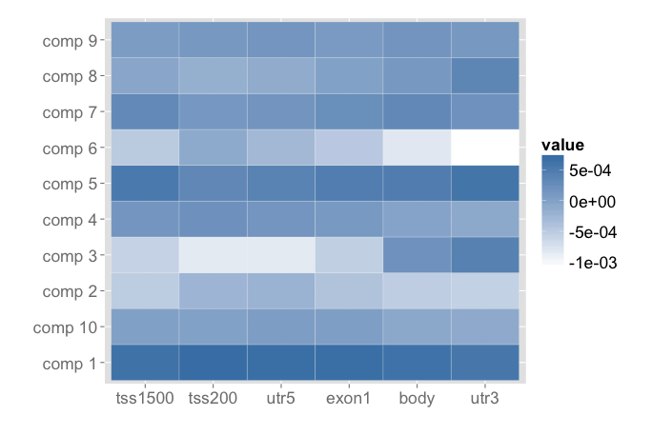
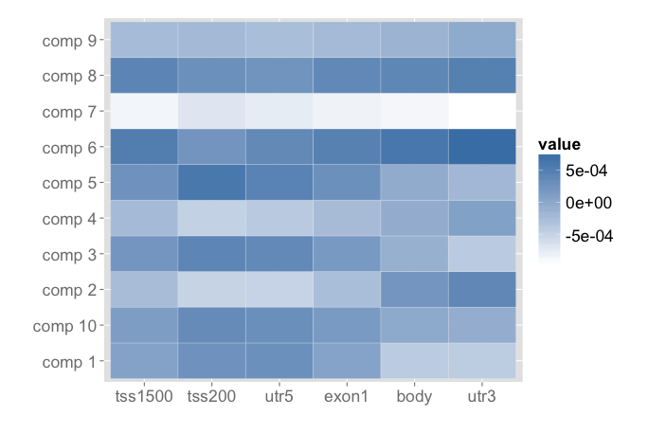
Sparse Partial Least Squares
Variable
NO_{x} NO₂
-> to be studied further

Slide 18
2nd Question
Does air pollution cause a change in overall DNA methylation?
NO_{x} – NO₂ : global hypomethylation
PM : not hypomethylation (with current techniques)
-> Progress study with cluster techniques
Can we identify CpG’s that are associated with air pollution?

Slide 19
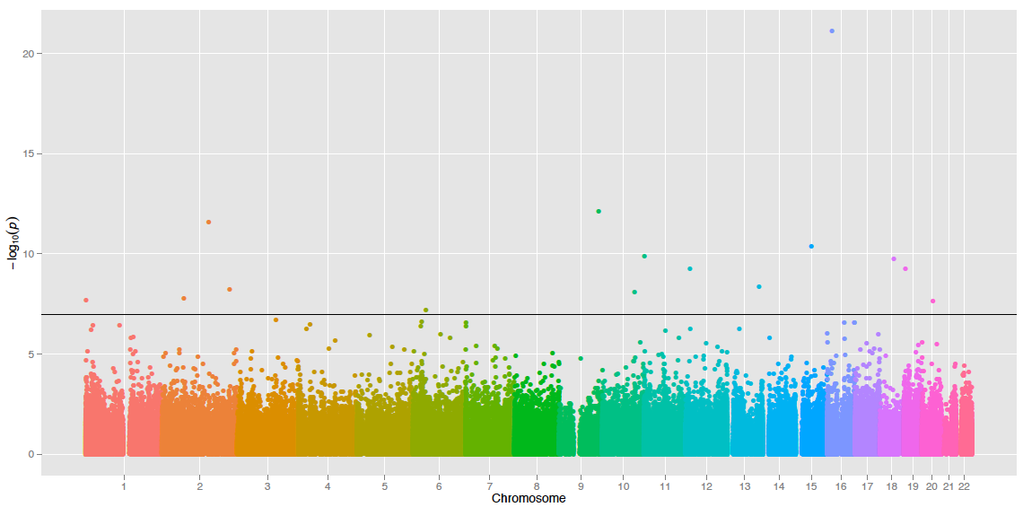
Epigenome wide association study: Manhattan plot NO_{x}
GA Binding Protein Transcription Factor
15 significant CpG’s
after bonferroni correction
Notes:
GABPB1 Gene:
This gene encodes the GA-binding protein transcription factor, beta subunit. This protein forms a tetrameric
complex with the alpha subunit, and stimulates transcription of target genes. The encoded protein may be involved
in activation of cytochrome oxidase expression and nuclear control of mitochondrial function. The crystal
structure of a similar protein in mouse has been resolved as a ternary protein complex.
Model used is B = No2 + chip + position + case/control status + age + gender + smoking

Slide 20
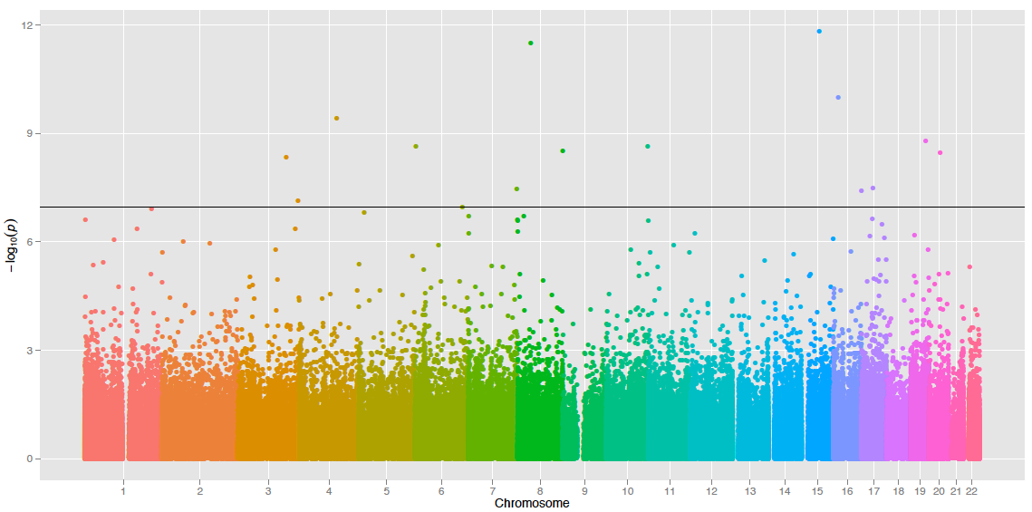
EWAS: Manhattan plot NO₂
COMMD5 (Hypertension-Related Calcium-Regulated Gene Protein)
15 significant CpG’s
after bonferroni correction

Slide 21
Intersect NO_{X} – NO₂
NOx
NO2
C16orf63

Slide 22
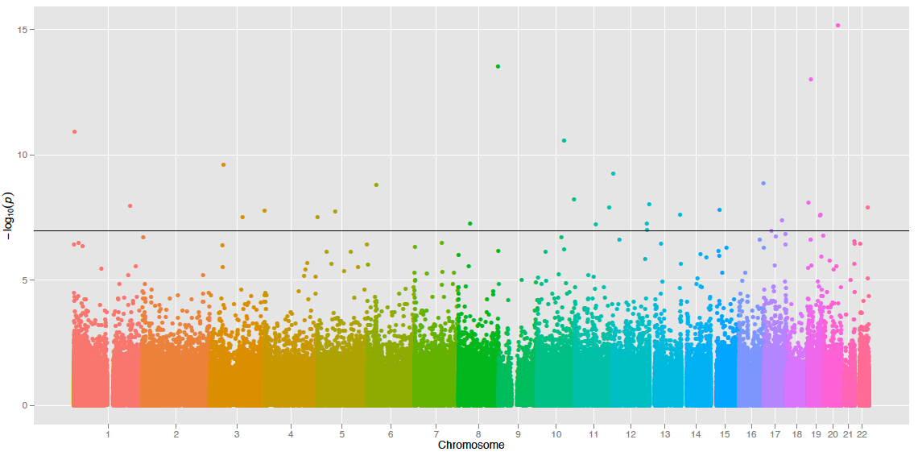
EWAS Manhattan plot pm_{2.5}
NFATC2: Nuclear factor of activated T-cells, cytoplasmic 2
29 significant CpG’s
after bonferroni correction
Notes:
This gene is a member of the nuclear factor of activated T cells (NFAT) family. The product of this gene is a DNA-binding protein with a REL-homology region (RHR) and an NFAT-homology region (NHR). This protein is present in the cytosol and only translocates to the nucleus upon T cell receptor (TCR) stimulation, where it becomes a member of the nuclear factors of activated T cells transcription complex. This complex plays a central role in inducing gene transcription during the immune response. Alternate transcriptional splice variants, encoding different isoforms, have been characterized

Slide 23
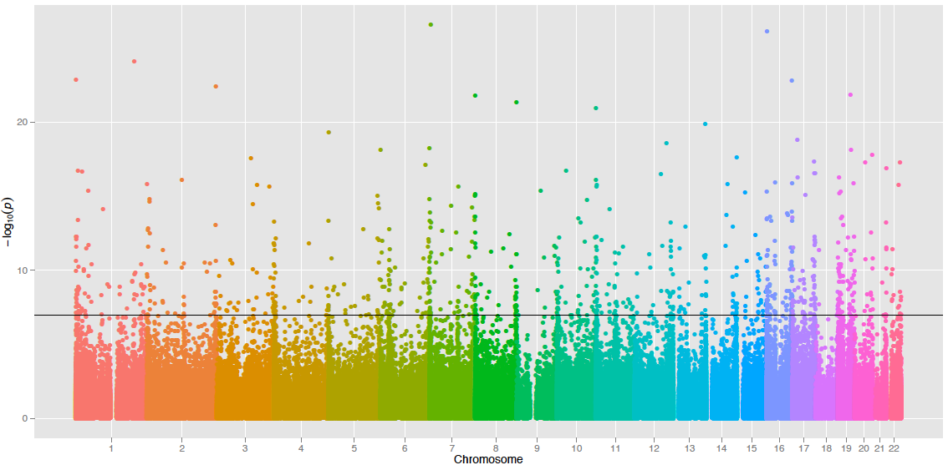
EWAS Manhattan plot pm₁₀
828 significant CpG’s
after bonferroni correction

Slide 24
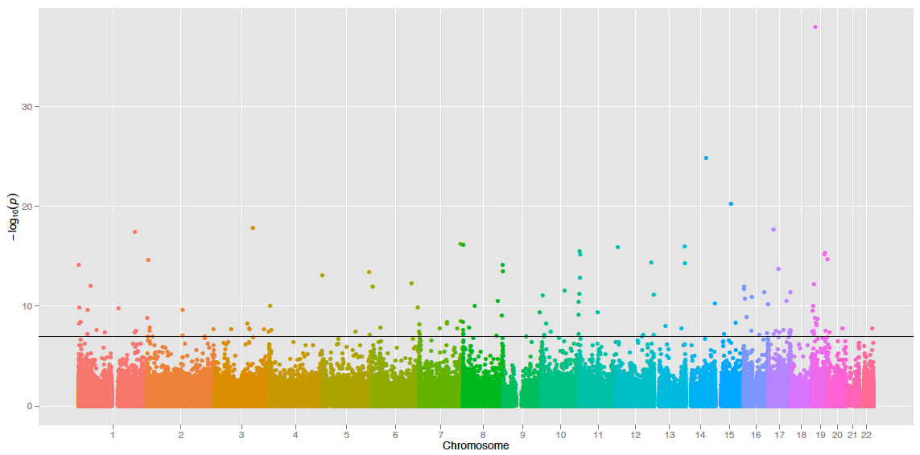
EWAS Manhattan plot pm_{25abs}
Dynamin-2
129 significant CpG’s
after bonferroni correction
Notes:
Housekeeping: Dynamins represent one of the subfamilies of GTP-binding proteins. These proteins share considerable sequence similarity over the N-terminal portion of the molecule, which contains the GTPase domain. Dynamins are associated with microtubules. They have been implicated in cell processes such as endocytosis and cell motility, and in alterations of the membrane that accompany certain activities such as bone resorption by osteoclasts. Dynamins bind many proteins that bind actin and other cytoskeletal proteins. Dynamins can also self-assemble, a process that stimulates GTPase activity. Four alternatively spliced transcripts encoding different proteins have been described. Additional alternatively spliced transcripts may exist, but their full-length nature has not been determined

Slide 25
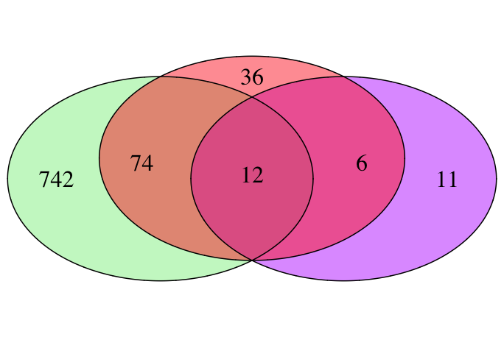
CpG Overlap between pm_{2.5} PM₁₀ PM_{25ABS}?
pm_{abs}
pm₁₀
pm₂₅

Slide 26
CpG Overlap between pm_{2.5} PM₁₀ PM_{25ABS}
IlmnID | CHR | MAPINFO | Abbreviation | Name | Group | Relation_to_CGI
cg21167817 | 1 | 3277557 | PRDM16 | PR Domain Containing 16 | Body | S_Shelf
cg20382344 | 1 | 204587945 | LRRN2 | Leucine-rich repeat neuronal protein 2 | Body | /
cg11337598 | 3 | 119121088 | CDGAP | CDC42 GTPase-activating protein | Body | Island
cg17276794 | 5 | 1474048 | LPCAT1 | Lysophosphatidylcholine Acyltransferase | Body | /
cg10366851 | 10 | 131406630 | MGMT | O-6-Methylguanine-DNA Methyltransferase | Body | /
cg17211612 | 12 | 124330647 | DNAH10 | Dynein, Axonemal, Heavy Chain 10 | Body | /
cg00124836 | 13 | 111295144 | CARS2 | cysteinyl-tRNA synthetase 2, mitochondrial | Body | S_Shore
cg05058069 | 16 | 88091975 | BANP | Scaffold/Matrix-Associated Region-1-Binding Protein | Body | /
cg19927510 | 19 | 10829071 | DNM2 | Dynamin 2 | 1stExon | Island
cg08337835 | 19 | 43918868 | TEX101 | testis expressed 101 | TSS200 | Island
cg02359773 | 19 | 46307846 | RSPH6A | Radial Spoke Head-Like Protein | Body | Island
cg10346758 | 22 | 47097389 | CERK | Ceramide Kinase | Body | Island

Slide 27
3rd Question
Does air pollution cause a change in overall DNA methylation?
NOx – NO2 -> global hypomethylation
PM –> no global hypomethylation
Can we identify CpG’s that are associated with air pollution?
Yes, several from different classes:
immune system, cardiovascular, housekeeping, genes, cell division genes
Are genes related to tumor development involved?

Slide 28
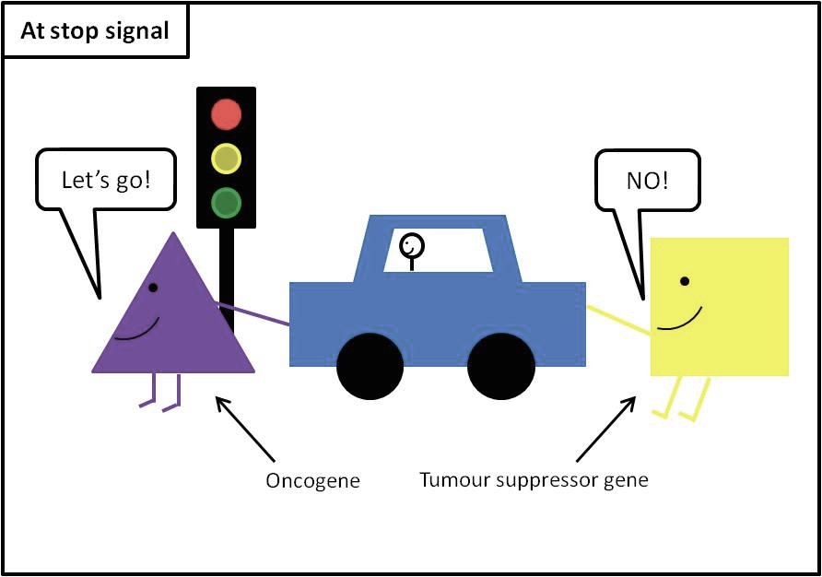
Oncogenes and tumor suppressor genes

Slide 29
Cell division and repair genes
MGMT, hypermethylation ^{(NOx, pm25, pm10, pm25abs)}
Methylguanine methyltransferase
Function in DNA damage repair
MAD1L1, hypermethylation ^{(NOx, pm10)}
MAD1 mitotic arrest deficient-like 1
plays a role in cell cycle control and tumor suppression
RBL1 (Retinoblastoma-Like 1), RPH3AL ^{(NO2)}
Cdc42 ^{(pm25abs)}
Cell division control protein 42 homolog
FGF14 ^{(NOx)}
Fibroblast growth factor 14
Notes:
RB1 gene product is a tumor suppressor protein that appears to be involved in cell cycle
regulation, as it is phosphorylated in the S to M phase transition and is dephosphorylated in the G1 phase of the
cell cycle
The protein encoded by this gene plays a direct regulatory role in calcium-ion-dependent exocytosis in both
endocrine and exocrine cells and plays a key role in insulin secretion by pancreatic cells. This gene is likely a
tumor suppressor. Alternative splicing results in multiple transcript variants encoding distinct isoforms.

Slide 30
Conclusion
First data on air pollution suggest that exposure to NO_{x} and NO₂ can lead to global hypomethylation studied with the Illumina array
Siginificant CpG sites associated with ESCAPE air pollution measures
Future perspectives
Study will be extended to differentiated methylation regions
Replicate study in cord blood and children age 7
-> ALSPAC

Slide 31
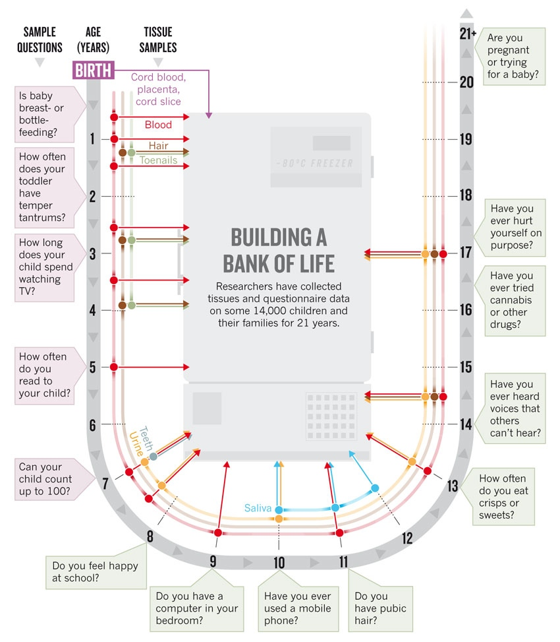
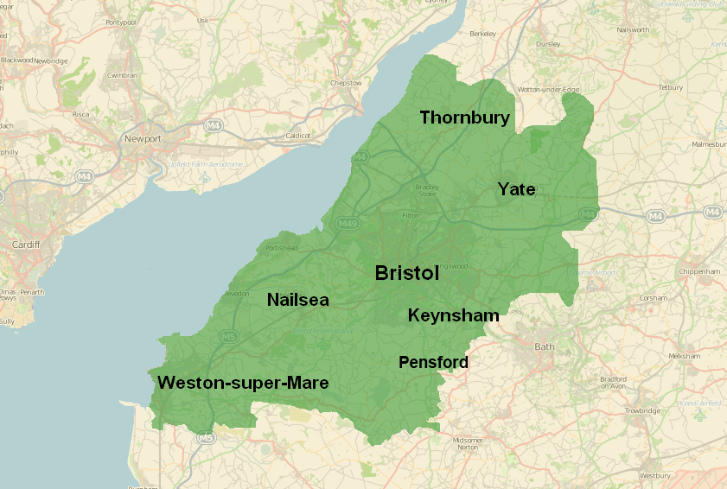
Avon Longitudinal Study of Parents and Children (ALSPAC)
Cohort: 15 445 children
Before birth until 20 years
59 questionnaires (4 weeks to 18 years)
9 clinical visits ( 7-17 years of age)
Children in focus (+1200 children)
Focus sessions (+8000 children)

Slide 32
Alspac and exposomics

Slide 33
ALSPAC and exposomics
Environmental exposures:
Air pollution exposure assessment (soon available)
Omics:
Epigenetics (currently ±1000 subjects): human Methylation 450K array Illumina in cord blood and blood at 7 years old
Metabolomics (± 5500 subjects): NMR spectroscopy at 7 years -> Karin van Velthoven
Notes:
Children in focus: randomly chosen (max 1314 child mother - pairs)
Focus @ 7: 8297 subj (in cohort untill 7 years)
Metabolomics: 5522 subj (I think in cohort until 17 years –TF3))

Slide 34
Acknowledgements

Slide 35
ALSPAC and Exposomics
Phenotypes:
Asthma (currently 216 cases with methylation -> will be expanded to 500)
Birth weight
Physiological and social behavior / development (questionnaire data)
Health records (GP, hospital)
Children in focus (± 1200, 10 clinics, until 5 years of age)
Anthropometry, blood pressure, lung function, skin, hair & eye observations, allergy testing, vision, hearing, dental
Cognition: habituation, memory, speech (Griffiths test and Wechsler preschool and primary scale of intelligence)
Focus sessions (± 8326, 9 clinics, 7 years untill 17)
Physical measures, bone density, fitness, vision, hearing, allergies, vascular function, lung function, acne
Cognitive / behavioral: IQ, speech & language, bullying, antisocial activities substance use, romantic relations, psychosis, depression
Early cardiovascular disease
Obesity
Respiratory function
Diabetes
Eating disorders
Depression
Neurodevelopment, autism
Intellectual disability
Puberty
Notes:
Cardiovascular disease
Obesity
Respiratory function,
Diabetes,
Eating disorders
Depression
Neurodevelopment, autism
Intellectual disability,

Slide 36
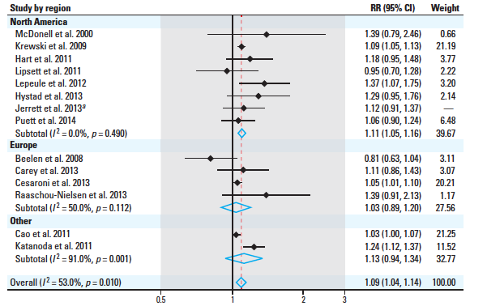
Air pollution health effect
PM25 and lung cancer (Hamra et al., 2014
weak positive association of high residential traffic exposure with BP in nonmedicated participants, and an elevated OR for prevalent hypertension. (Fuks 2014)

Slide 37
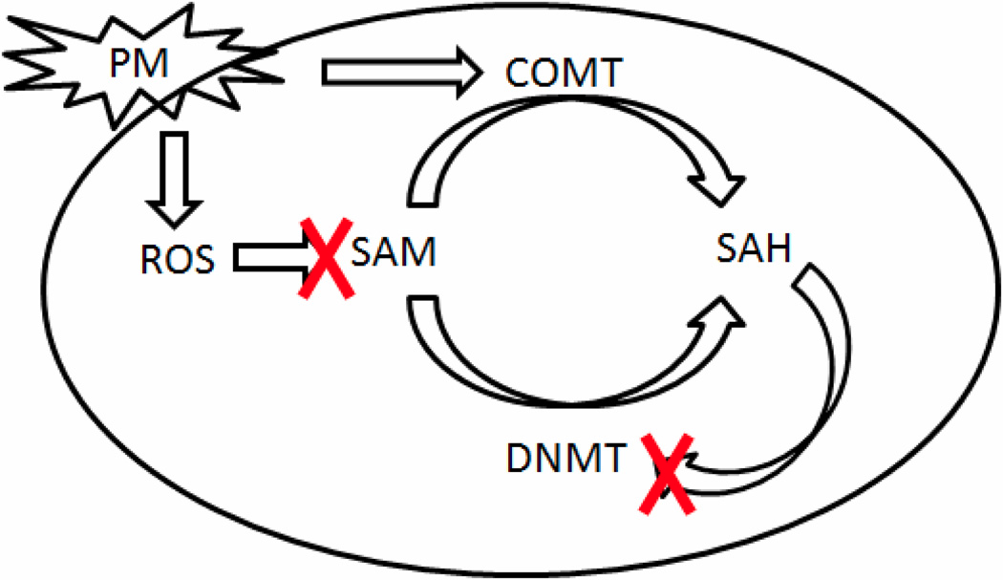
Notes:
Global hypomethylation

Slide 38
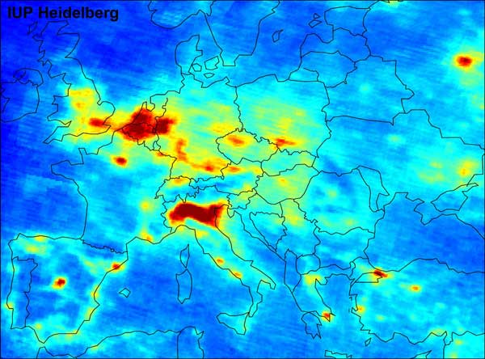
Notes:
NO2

